Slide 1
ONLINE DOCTOR APPOINTMENT SYSTEM
Project Review-1

Slide 2
Team Members
2110030020-Ch.Sri Chandana
2110030032-D.Neha
2110030056-B.Akshita
2110030457-V.Charishma

Slide 3
Problem statement and domain
Problem statement: The management of records and doctor appointment would become difficult for the hospital in general. Adjusting the schedules for appointment would become difficult. Communication between the doctor and patient would sometimes become difficult.
Aim: The aim of this project is to develop a online doctor visit web application. This research project is aimed at computerizing all the records about patients, Hospital and doctors. The concept of report production has been computerized hence, no more delay in report generation to the hospital, patient and doctor.
Objectives:
To create web based Online Doctor Appointment management system.
To manage all patient related information.
To create an user friendly web application.

Slide 4
Proposed Algorithm Design Technique
The proposed project is a smart appointment booking system that provides patients or any user an easy way of booking a doctor’s appointment online. This is a web based application that overcomes the issue of managing and booking appointments according to user’s choice or demands. The task sometimes becomes very difficult for the compounder or doctor himself in manually allotting appointments for the users as per their availability. Hence this project offers an effective solution where users can view various booking slots available and select the preferred date and time. The already booked space will be marked yellow and will not be available for anyone else for the specified time. This system also allows users to cancel their booking anytime. The system provides an additional feature of calculating monthly earnings of doctor. In this project the database management system software is used in the backend in this project.

Slide 5
Literature review
There are many existing online doctor appointment applications already developed. Some of them are:
Apollo 24*7, Lybrate, Doctor on Demand, Am well, MD Live, My Health
The disadvantages of these applications are :
Sometimes it is possible that the patient may not be able to communicate their problems clearly online and the patient may need direct consultation of the doctor rather than online.
It might be inconvenient for old or illiterate people as they may not know how to use the application properly.
Any activity conducted online will have hacker related security issues. Maintenance of privacy could be a problem in telemedicine.

Slide 6
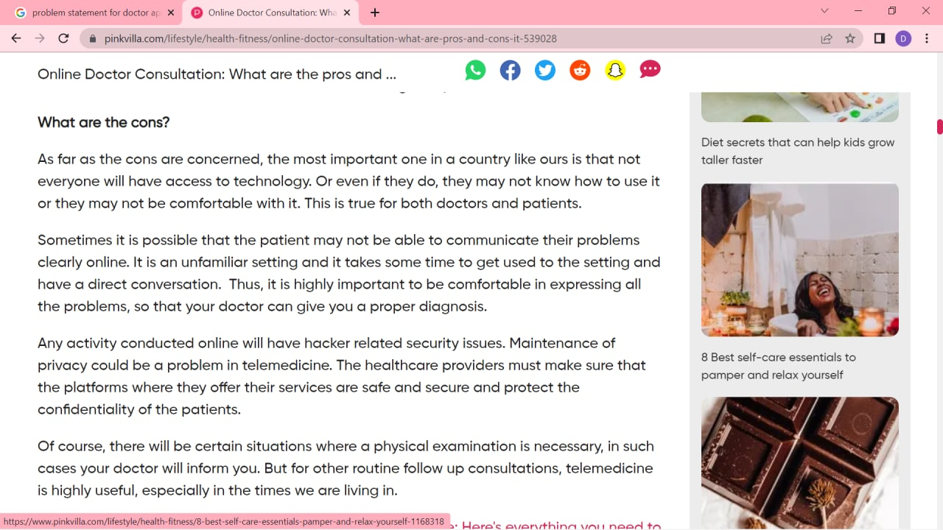
Article review
https://www.pinkvilla.com/lifestyle/health-fitness/online-doctor-consultation-what-are-pros-and-cons-it-539028

Slide 7
HOW DOES IT WORK
First create an account and sign-in to it by giving appropriate details.
There will be a voice assistant available and the user can select the language he needed.
Book a slot which is convenient to the user.
Make payment through the online pay system.
Be present in the consult room at the time of consult.
Express your concern to the doctor.
Receive prescriptions instantly.
Slot can also be cancelled if not required.

Slide 8
FEATURES
We implement this application for better user experience. This application is very easy to access. Also for establishing real time communication, using modern and updated technology. So, user can see the update.
This application will compatible with user device such as pc, laptop, tab and smart phone. So, user can easily access the application anytime and anywhere. This application is very simple and user friendly so ,any user can use this application easily.
We also provide security so that the data is secured from dangerous activities like hacking and loss of data which is already stored.
We provide the application in a user friendly way by providing voice assistance so that illiterate and old people can also use the application easily in their convenient language.
We also provide direct service of doctor if needed by the patient.

Slide 9
Project requirements
Software requirements for the project are:
Star UML is the software required for design modelling diagrams like use case diagram, class diagram, data flow diagrams which shows the design of the application.
Runtime Environment like vs code or any other text editor which is used to write the programming part in the front end.
My SQL is the software used for storing the data and for database management in the backend.

Slide 10
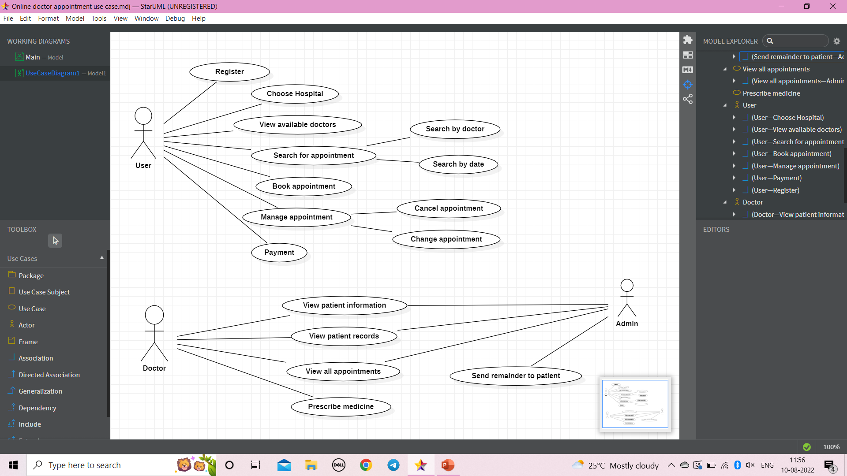
Use case diagram

Slide 11
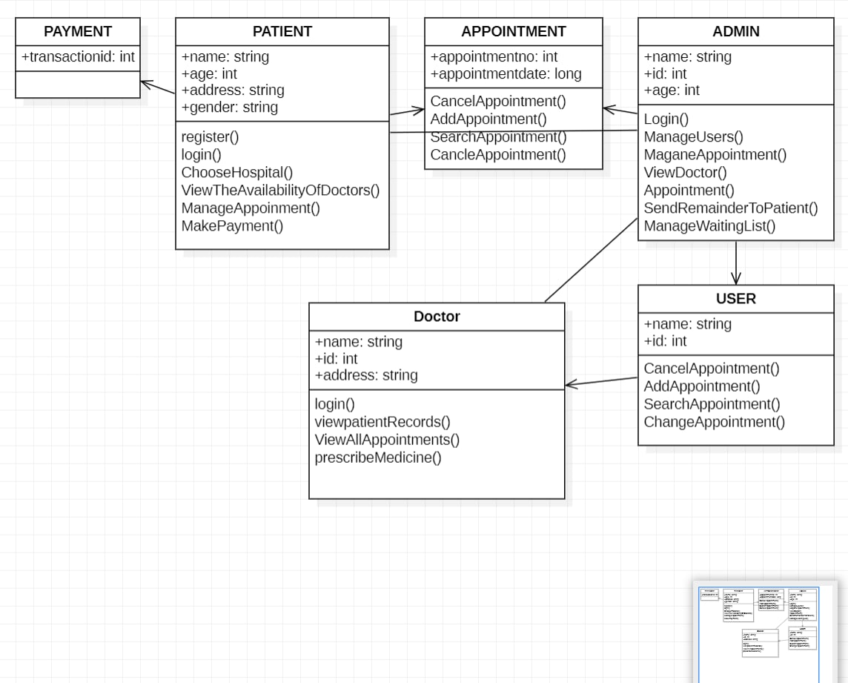
Class diagram

Slide 12
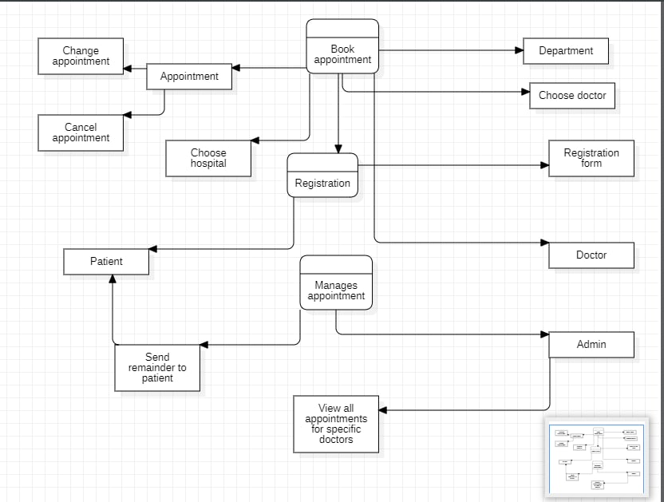
Data flow diagram

Slide 13
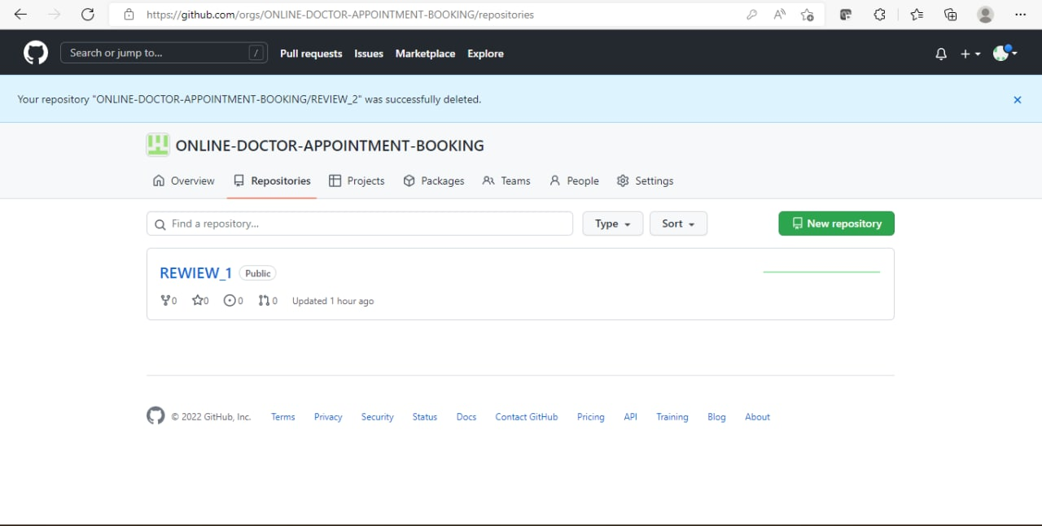
Git hub setup

Slide 14
Team members contribution
2110030020-Ch.Sri Chandana: Problem statement and Use case diagram
2110030032-D.Neha: Features and Class diagram
2110030056-B.Akshita: Working and Data flow diagram
2110030457-V.Charishma:Project requirements and data flow diagram

Slide 15
THANK YOU

